Slide 1
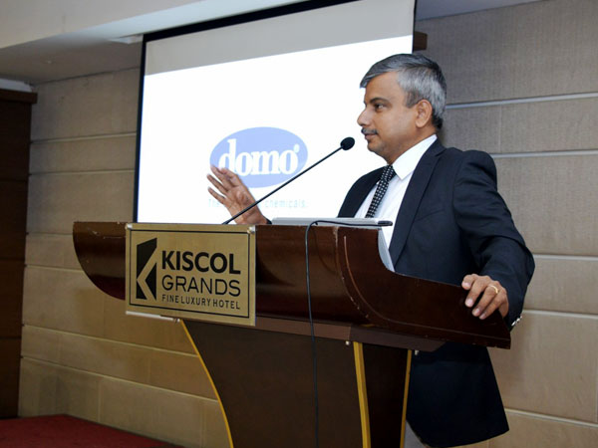
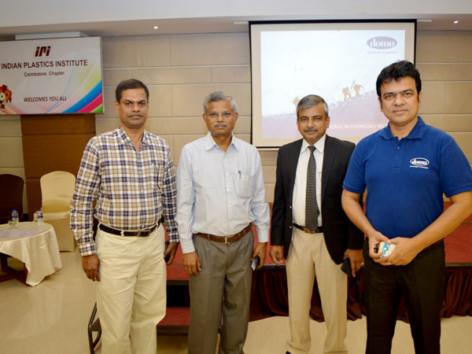
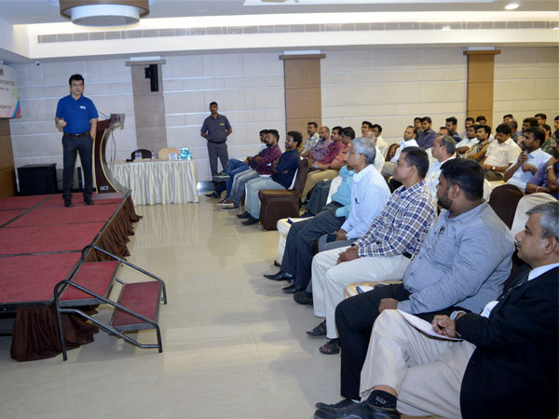
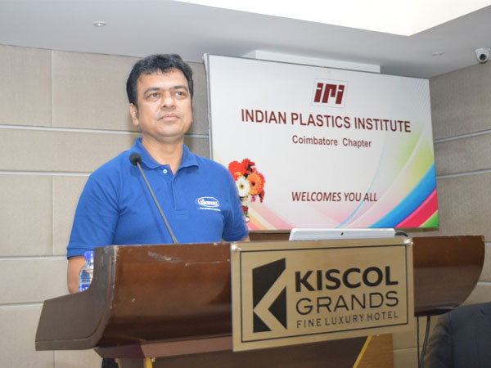
Technical Presentation on
“LIGHT WEIGHT SOLUTIONS USING DOMO ENGINEERING PLASTICS”
By
Mr. Tushar Parida
Date & Time : Friday 25th May 2019 | 6:00 PM to 8.00 PM

