Slide 1
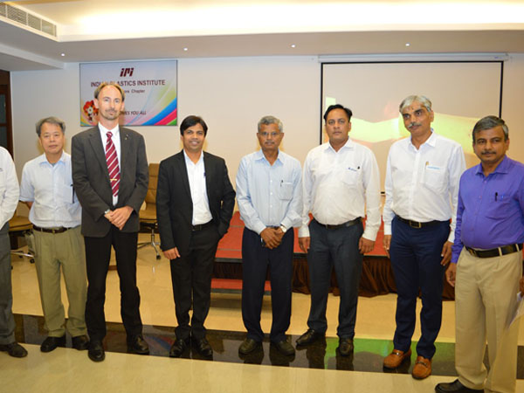
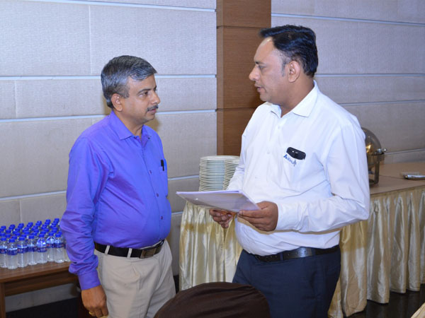
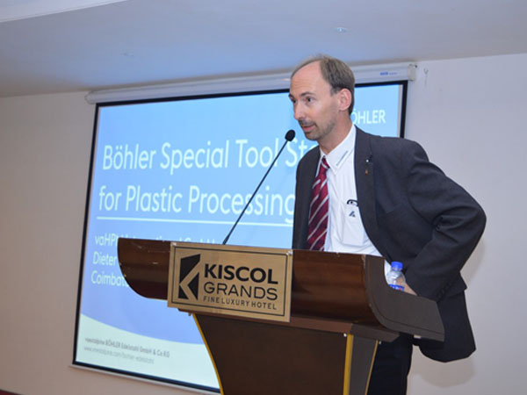
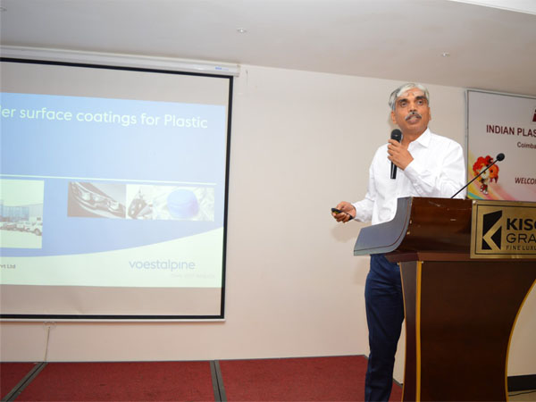
Technical Presentation on
BOHLER
Date & Time : Saturday 22nd June 2019 | 6:45 PM to 8.15 PM
Folllowed by Dinner

